Slide 1

Academic Session 2026-27
ODD Semester July-Dec 2026
UNIVERSITY INSTITUTE OF ENGINEERING AND TECHNOLOGY
Department of TT
Bachelor of Engineering (B.E.) – CSE
Advanced Data Structures / Semester 3
(CS221)
Unit No. 1 Chapter No. 1.1 Lecture No. 3
Topic : Introduction to Sorting; Algorithm Complexity, Time-Space Tradeoff & Asymptotic Notations
Abhishek Thakur (E19789) Technical Trainer
Sourav Jaiswal (E19756)-MSC Technical Trainer

Slide 2
Learning Objectives
Understand sorting and why it is essential in computing.
Explain algorithm complexity in terms of time and space.
Describe the Time-Space Tradeoff with practical programming examples.
Apply Big-O, Omega, and Theta notations to classify algorithm efficiency.

Slide 3
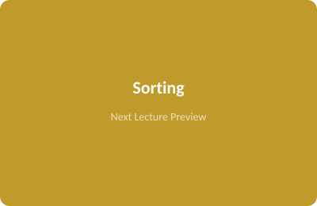
Introduction to Sorting
Sorting: Arranging data elements in a specific order — ascending or descending.
Why sort: Binary search requires sorted data; sorted data enables faster processing.
Comparison-based: Bubble, Selection, Insertion — O(n²); Merge, Quick Sort — O(n log n).
Non-comparison: Counting Sort, Radix Sort, Bucket Sort — can achieve O(n).
Stability: A stable sort preserves the relative order of equal elements.

Slide 4
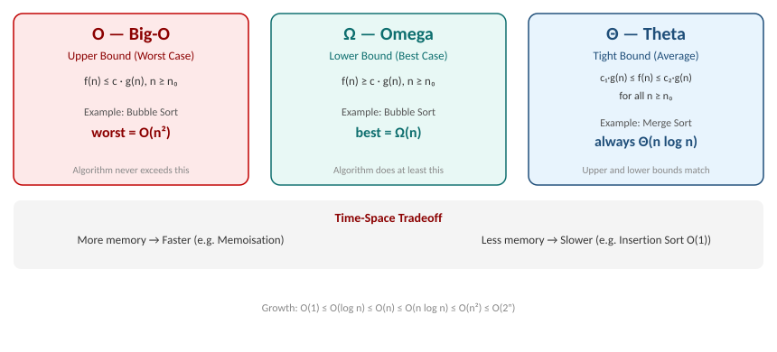
Asymptotic Notations: Big-O, Omega, Theta & Time-Space Tradeoff

Slide 5
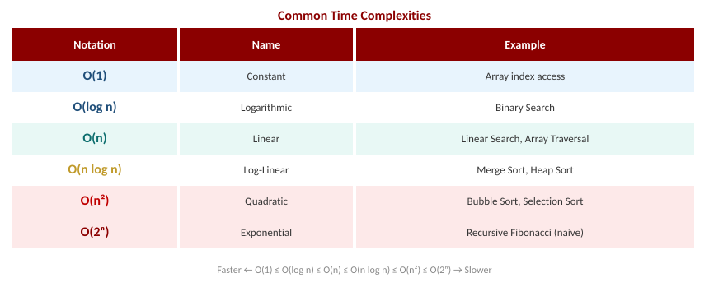
Common Time Complexities — Reference Table

Slide 6
Summary of the Lecture
Sorting arranges data for efficient searching, analysis, and further processing.
Time complexity counts operations; space complexity measures memory as n grows.
Big-O: upper bound (worst case). Omega: lower bound (best case). Theta: tight bound.
Time-Space Tradeoff: extra memory can reduce execution time (e.g. memoisation/DP).
Selecting the right algorithm requires balancing time and space for the given context.

Slide 7

Next Lecture
Linear Arrays – memory representation, address computation, and traversal algorithm.

Slide 8
Quiz/ FAQ's
Q1. Explain Big-O, Omega, and Theta notations with one example each.
Q2. What is the Time-Space Tradeoff? Give a real programming example.
Q3. Which sorting algorithm has O(n²) worst case? Which has O(n log n) worst case?

Slide 9
References/ Articles
Cormen et al., Introduction to Algorithms (CLRS), 3rd Ed., MIT Press.
GeeksforGeeks – Asymptotic Notations: https://www.geeksforgeeks.org/asymptotic-notations/
Khan Academy – Algorithms: https://www.khanacademy.org/computing/computer-science/algorithms

Slide 10
Thank You
For queries
Email: abhishek.e19789@cumail.in

